Slide 1
Internet Protocol Version 6 (IPV6)
By
Antony Christopher

Slide 2
IPV6
Newer Version of IP
Replaces IPV4
Many new Features
Critical improvements

Slide 3
Limitations of IPV4
Unable to support a huge increase in the number of Users
IPV4 address depletion is approaching

Slide 4
IPV4 Life Time extended
Network Address Translation (NAT)
Classless Inter Domain Routing
Dynamic Host Configuration Protocol

Slide 5
IPV4 inadequate for:
Network and user mobility
Always-on environments
Plug-and-Play protocol requirements
New capabilities or larger network

Slide 6
New Version of IP
New and enhanced Features
Solve the IP address exhaustion Problem
IPV6

Slide 7
IPV6
Global environment
Transparent addressing rules
Auto configuration
Plug-and-play support

Slide 8
IPV6 Benefits
Larger Address Space
Reachability
Scalability
Almost unlimited number of IP addresses
Hierarchical network architecture
Global address for each network device
Enables end to end Reachability.
2001:0db8:85a3:08d3:1319:8a2e:0370:7334

Slide 9
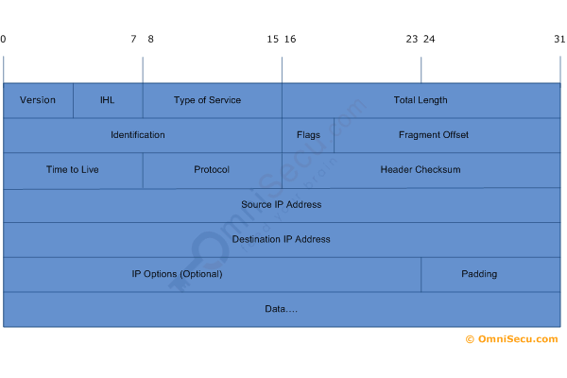
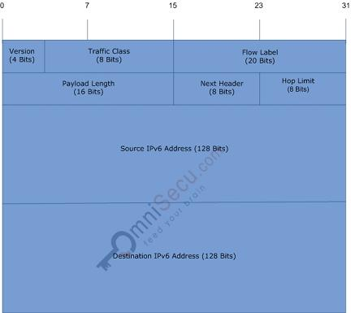
IPV6 Benefits
Simplified Header Format
Improves efficiency
New features

Slide 10
IPV6 Benefits
Embedded Security
Mandatory IPsec Implementation
IPsec in every Node

Slide 11
IPV6 Benefits
Multicast (Not broadcast)
Better Network Performance
ICMPV6 protocol
Auto Configuration
Neighbor Discovery
Multicasting
Built-in Mobility

Slide 12


